Slide 1
Proposition Logic Proving
Forward Chaining
Backward Chaining
Resolution

Slide 2
A proof system is sound if everything that is provable is in fact true.
In other words, if φ1, …, φn⊢ψ then φ1, …, φn⊨ψ.
Soundness = means that the logical system only concludes things that make sense (and makes no contradictions). So if a statement is returned from a proof by the system, it must be true. It might not address every possible question, but whatever it answers, its correct.
A proof system is complete if everything that is true has a proof.
In other words, if φ1, …, φn⊨ψ then φ1, …, φn⊢ψ.
Complete = means exactly that, its complete. In the sense that it addresses every true statement. If a statement is true, then its addressed by the logic system (i.e. a proof for that statement exists).
But unfortunately, not every proof is about a true statement, but all true statements for sure are covered (i.e. completely covers them all).
⊢ provability
⊨ truth

Slide 3
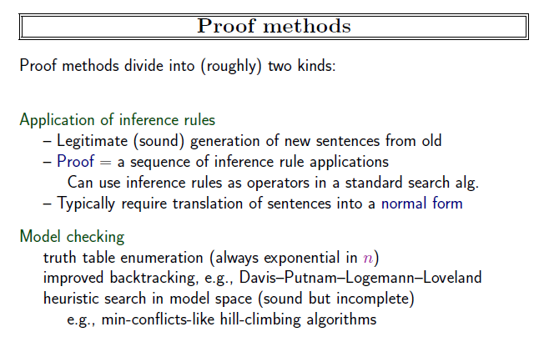
Artificial Intelligence: A Modern Approach, 4th US ed.
aima.cs.berkeley.edu by Stuart Russell

Slide 4

Horn Form
KB conjunction of horn clauses..
Horn clause: at most one literal is positive.
Definite clauses: Exactly one literal is positive.
Horn clauses can be re-written as implications.
Proposition symbols (Fact)
Conjunction of symbols (body or premise)->symbol (head)
Modus ponens for Horn KB:
Artificial Intelligence: A Modern Approach, 4th US ed.
aima.cs.berkeley.edu by Stuart Russell

Slide 5
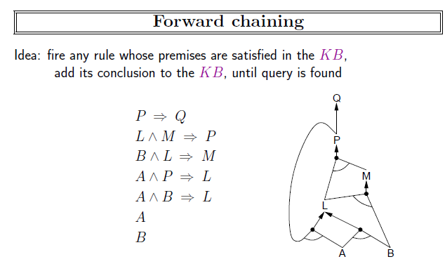
Artificial Intelligence: A Modern Approach, 4th US ed.
aima.cs.berkeley.edu by Stuart Russell

Slide 6
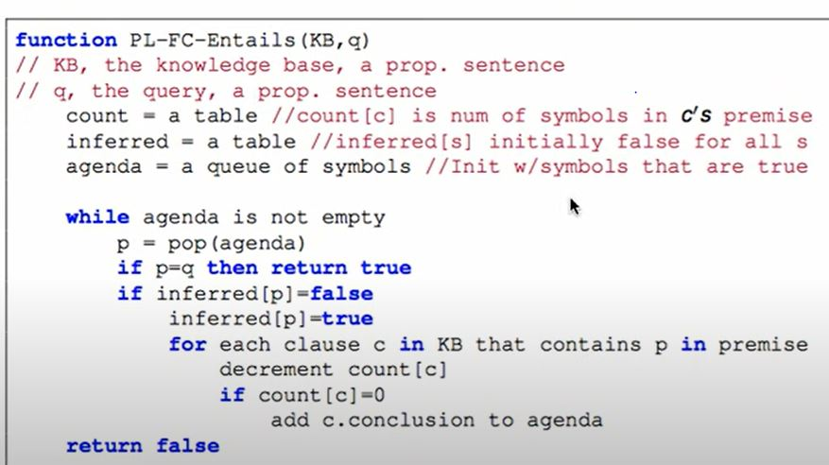
https://www.youtube.com/watch?v=PMm5Mat0MRA

Slide 7
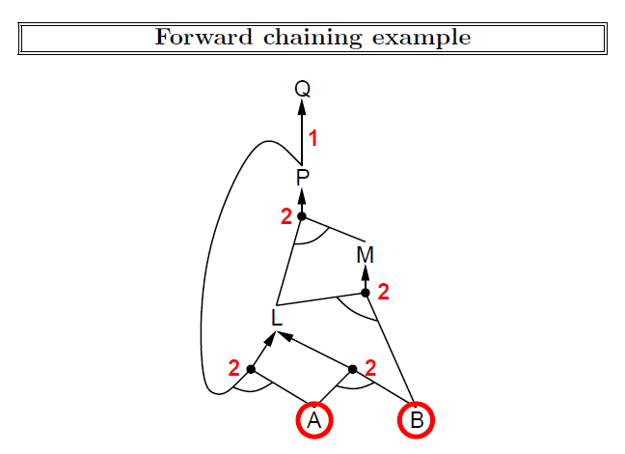
Artificial Intelligence: A Modern Approach, 4th US ed.
aima.cs.berkeley.edu by Stuart Russell

Slide 8
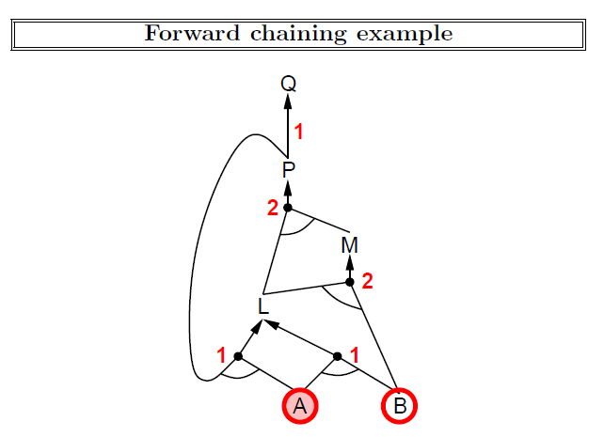
Artificial Intelligence: A Modern Approach, 4th US ed.
aima.cs.berkeley.edu by Stuart Russell

Slide 9
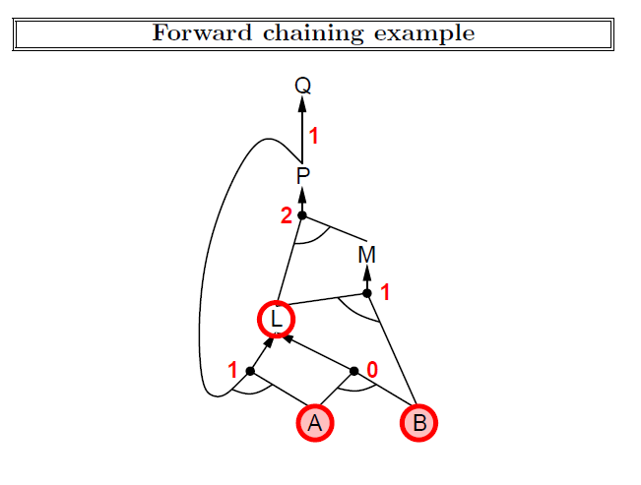
Artificial Intelligence: A Modern Approach, 4th US ed.
aima.cs.berkeley.edu by Stuart Russell

Slide 10
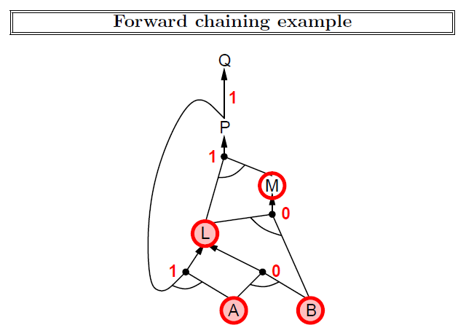
Artificial Intelligence: A Modern Approach, 4th US ed.
aima.cs.berkeley.edu by Stuart Russell

Slide 11
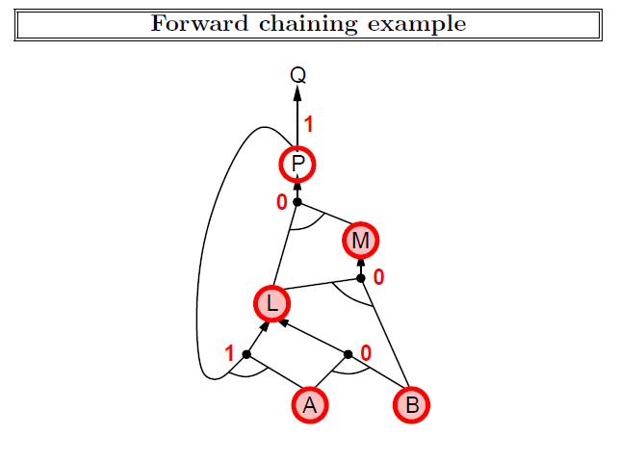
Artificial Intelligence: A Modern Approach, 4th US ed.
aima.cs.berkeley.edu by Stuart Russell

Slide 12
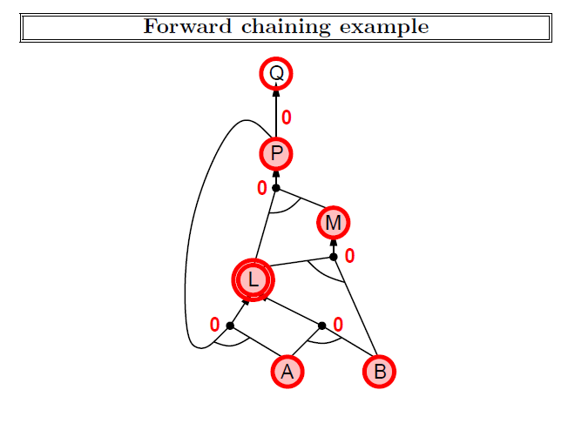
Artificial Intelligence: A Modern Approach, 4th US ed.
aima.cs.berkeley.edu by Stuart Russell

Slide 13
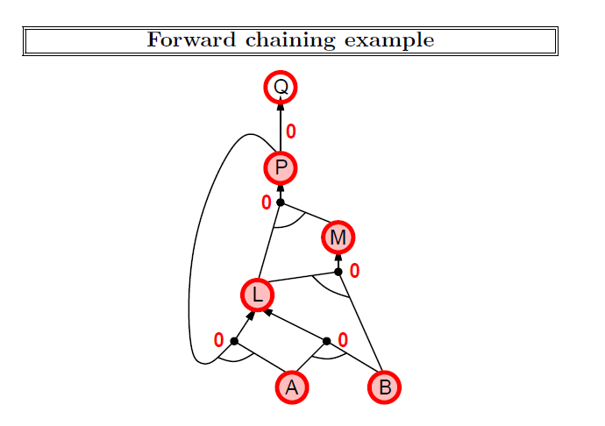
Artificial Intelligence: A Modern Approach, 4th US ed.
aima.cs.berkeley.edu by Stuart Russell

Slide 14
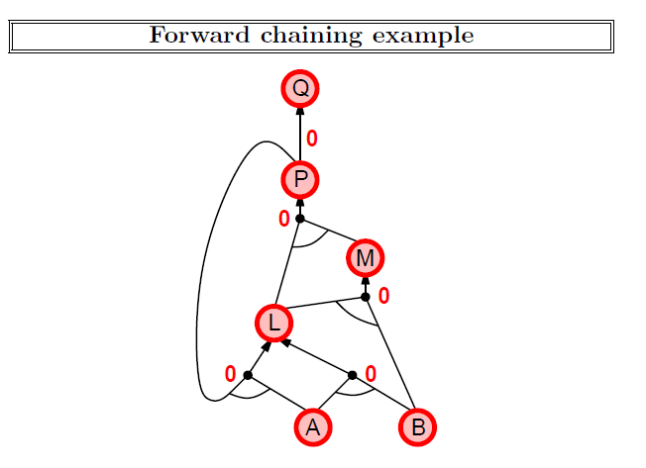
Artificial Intelligence: A Modern Approach, 4th US ed.
aima.cs.berkeley.edu by Stuart Russell

Slide 15
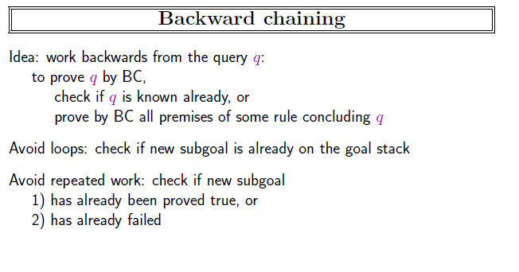
Artificial Intelligence: A Modern Approach, 4th US ed.
aima.cs.berkeley.edu by Stuart Russell

Slide 16
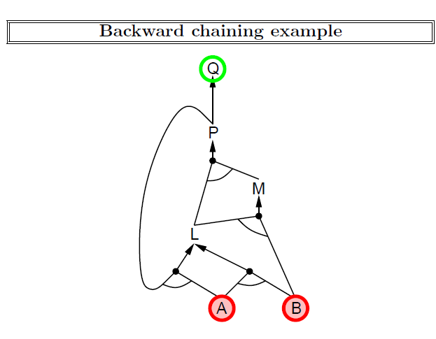
Artificial Intelligence: A Modern Approach, 4th US ed.
aima.cs.berkeley.edu by Stuart Russell

Slide 17
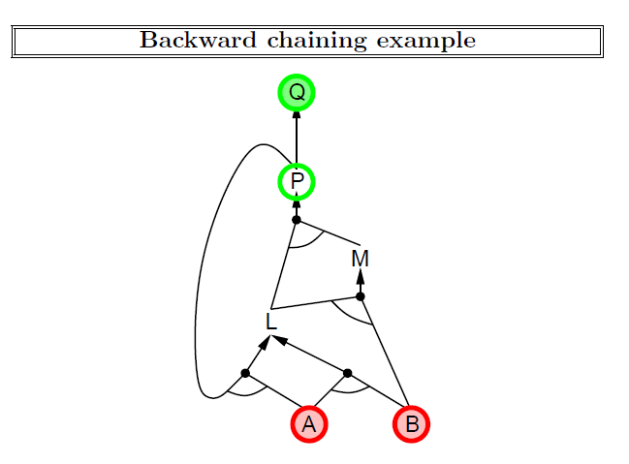
Artificial Intelligence: A Modern Approach, 4th US ed.
aima.cs.berkeley.edu by Stuart Russell

Slide 18
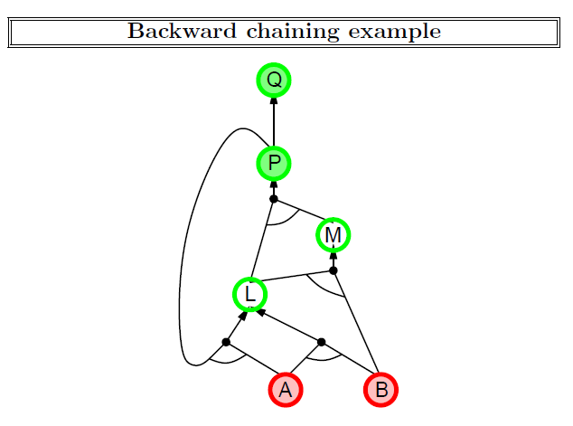
Artificial Intelligence: A Modern Approach, 4th US ed.
aima.cs.berkeley.edu by Stuart Russell

Slide 19
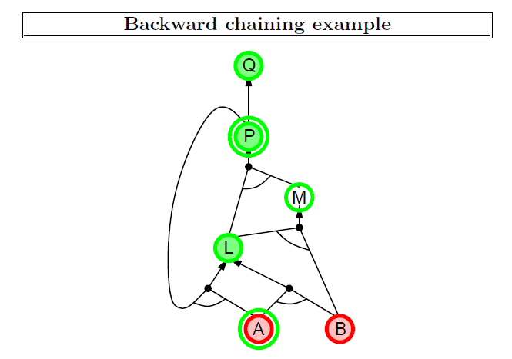
Artificial Intelligence: A Modern Approach, 4th US ed.
aima.cs.berkeley.edu by Stuart Russell

Slide 20
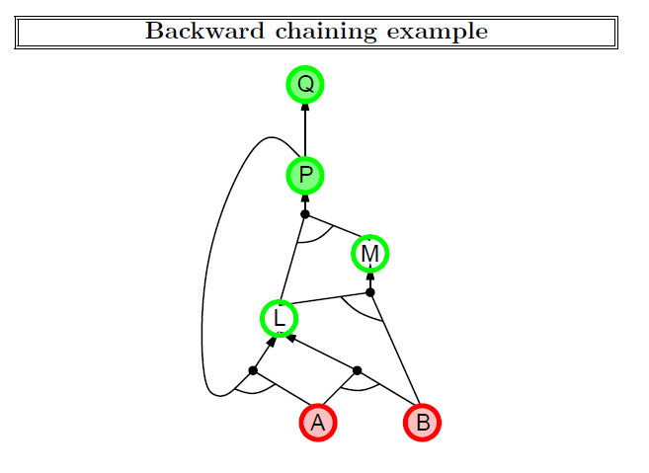
Artificial Intelligence: A Modern Approach, 4th US ed.
aima.cs.berkeley.edu by Stuart Russell

Slide 21
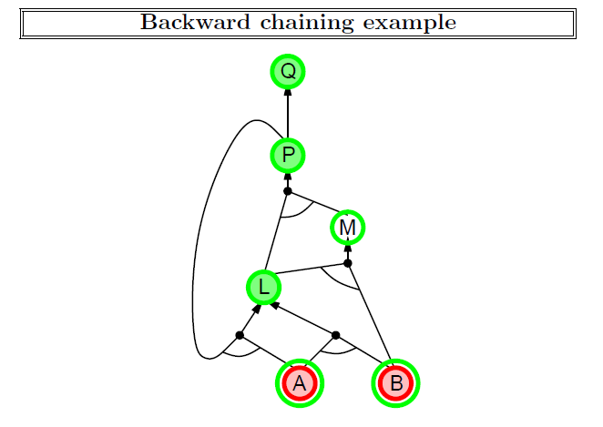
Artificial Intelligence: A Modern Approach, 4th US ed.
aima.cs.berkeley.edu by Stuart Russell

Slide 22
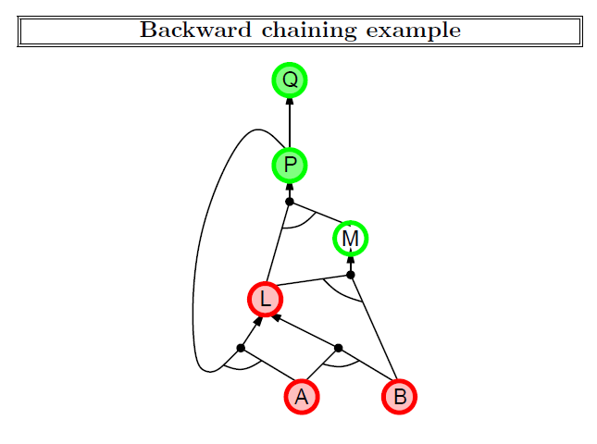
Artificial Intelligence: A Modern Approach, 4th US ed.
aima.cs.berkeley.edu by Stuart Russell

Slide 23
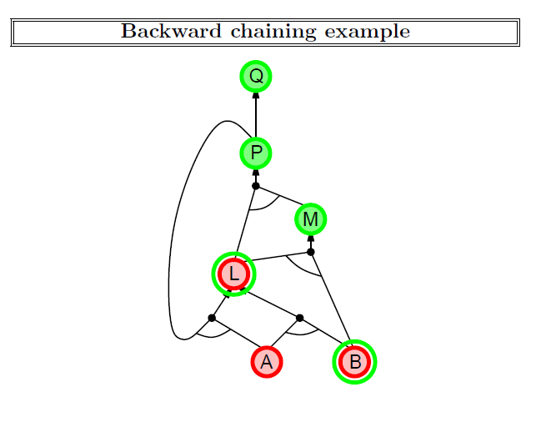
Artificial Intelligence: A Modern Approach, 4th US ed.
aima.cs.berkeley.edu by Stuart Russell

Slide 24
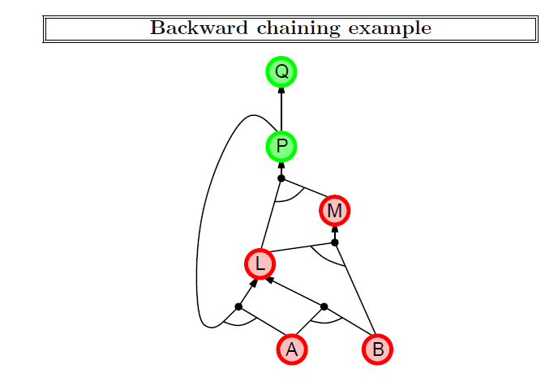
Artificial Intelligence: A Modern Approach, 4th US ed.
aima.cs.berkeley.edu by Stuart Russell

Slide 25
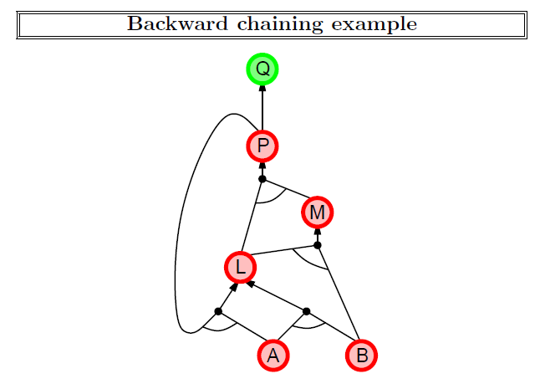
Artificial Intelligence: A Modern Approach, 4th US ed.
aima.cs.berkeley.edu by Stuart Russell

Slide 26
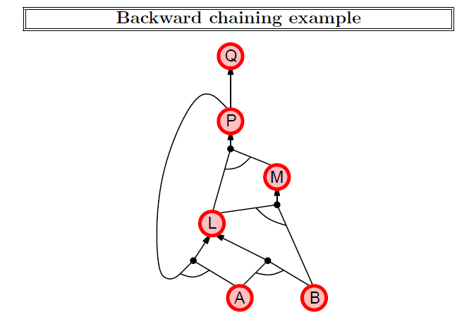
Artificial Intelligence: A Modern Approach, 4th US ed.
aima.cs.berkeley.edu by Stuart Russell

Slide 27
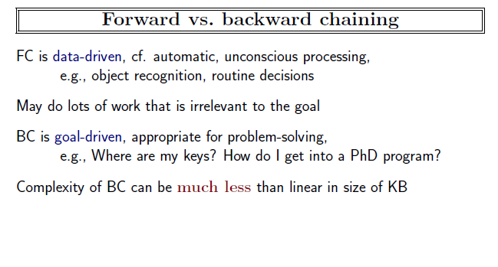
Artificial Intelligence: A Modern Approach, 4th US ed.
aima.cs.berkeley.edu by Stuart Russell

Slide 28

Resolution
Algorithm works using proof by contradiction.
To show KB╞ α we show that KB ∧¬α is not satisfiable.
Apply resolution to KB ∧¬α in CNF
Resolve pairs with complementary literals.
And add new clauses.
Until
There are no new clauses to be added
Two caluses resolve to the empty class (means KB ╞ α).
Artificial Intelligence: A Modern Approach, 4th US ed.
aima.cs.berkeley.edu by Stuart Russell
Notes:
Resolution
Fwd Chaining
Bwd Chaining

Slide 29
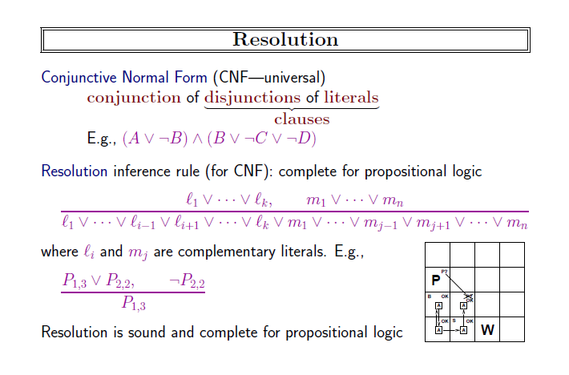
Artificial Intelligence: A Modern Approach, 4th US ed.
aima.cs.berkeley.edu by Stuart Russell
Notes:
Look for Pairs that are complementary and resolve them
Add resolved sentences to the KB

Slide 30
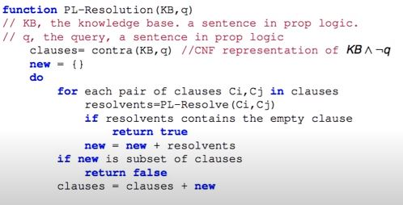
Algorithm
https://www.youtube.com/watch?v=PMm5Mat0MRA

Slide 31
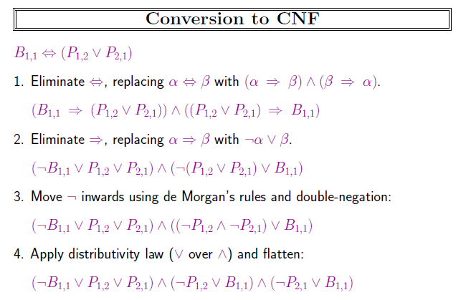
Artificial Intelligence: A Modern Approach, 4th US ed.
aima.cs.berkeley.edu by Stuart Russell

Slide 32
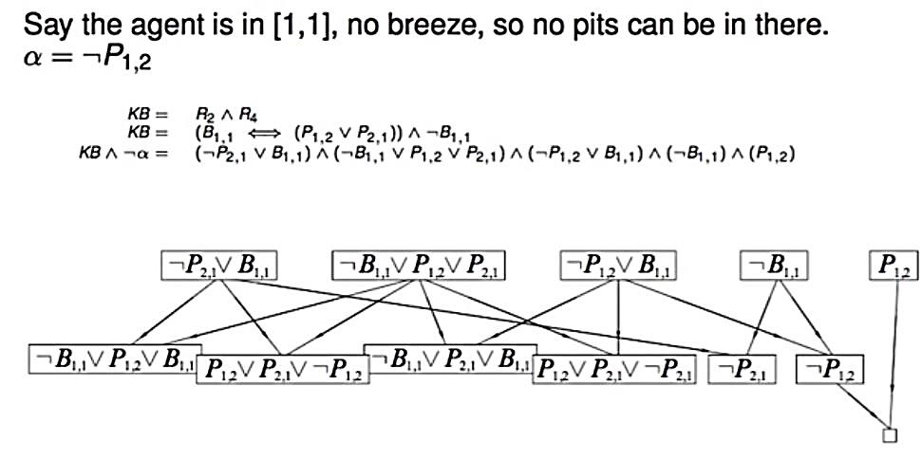
https://www.youtube.com/watch?v=PMm5Mat0MRA

Slide 33
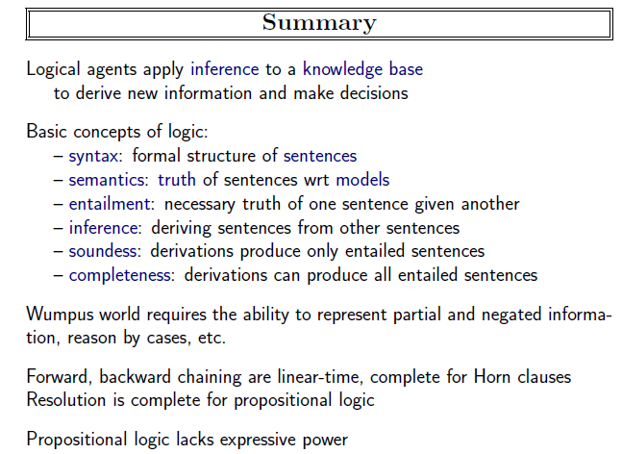
Artificial Intelligence: A Modern Approach, 4th US ed.
aima.cs.berkeley.edu by Stuart Russell

Slide 34
References
https://www.youtube.com/watch?v=PMm5Mat0MRA
Artificial Intelligence: A Modern Approach, 4th US ed.
aima.cs.berkeley.edu by Stuart Russell

